Slide 1




Retail Banking – GenAI Personal Finance Advisor
AI-Powered Personal Financial Wellness
Anant Papewar Anvit Kamble Puja Basak Uttaran Naha

Slide 2
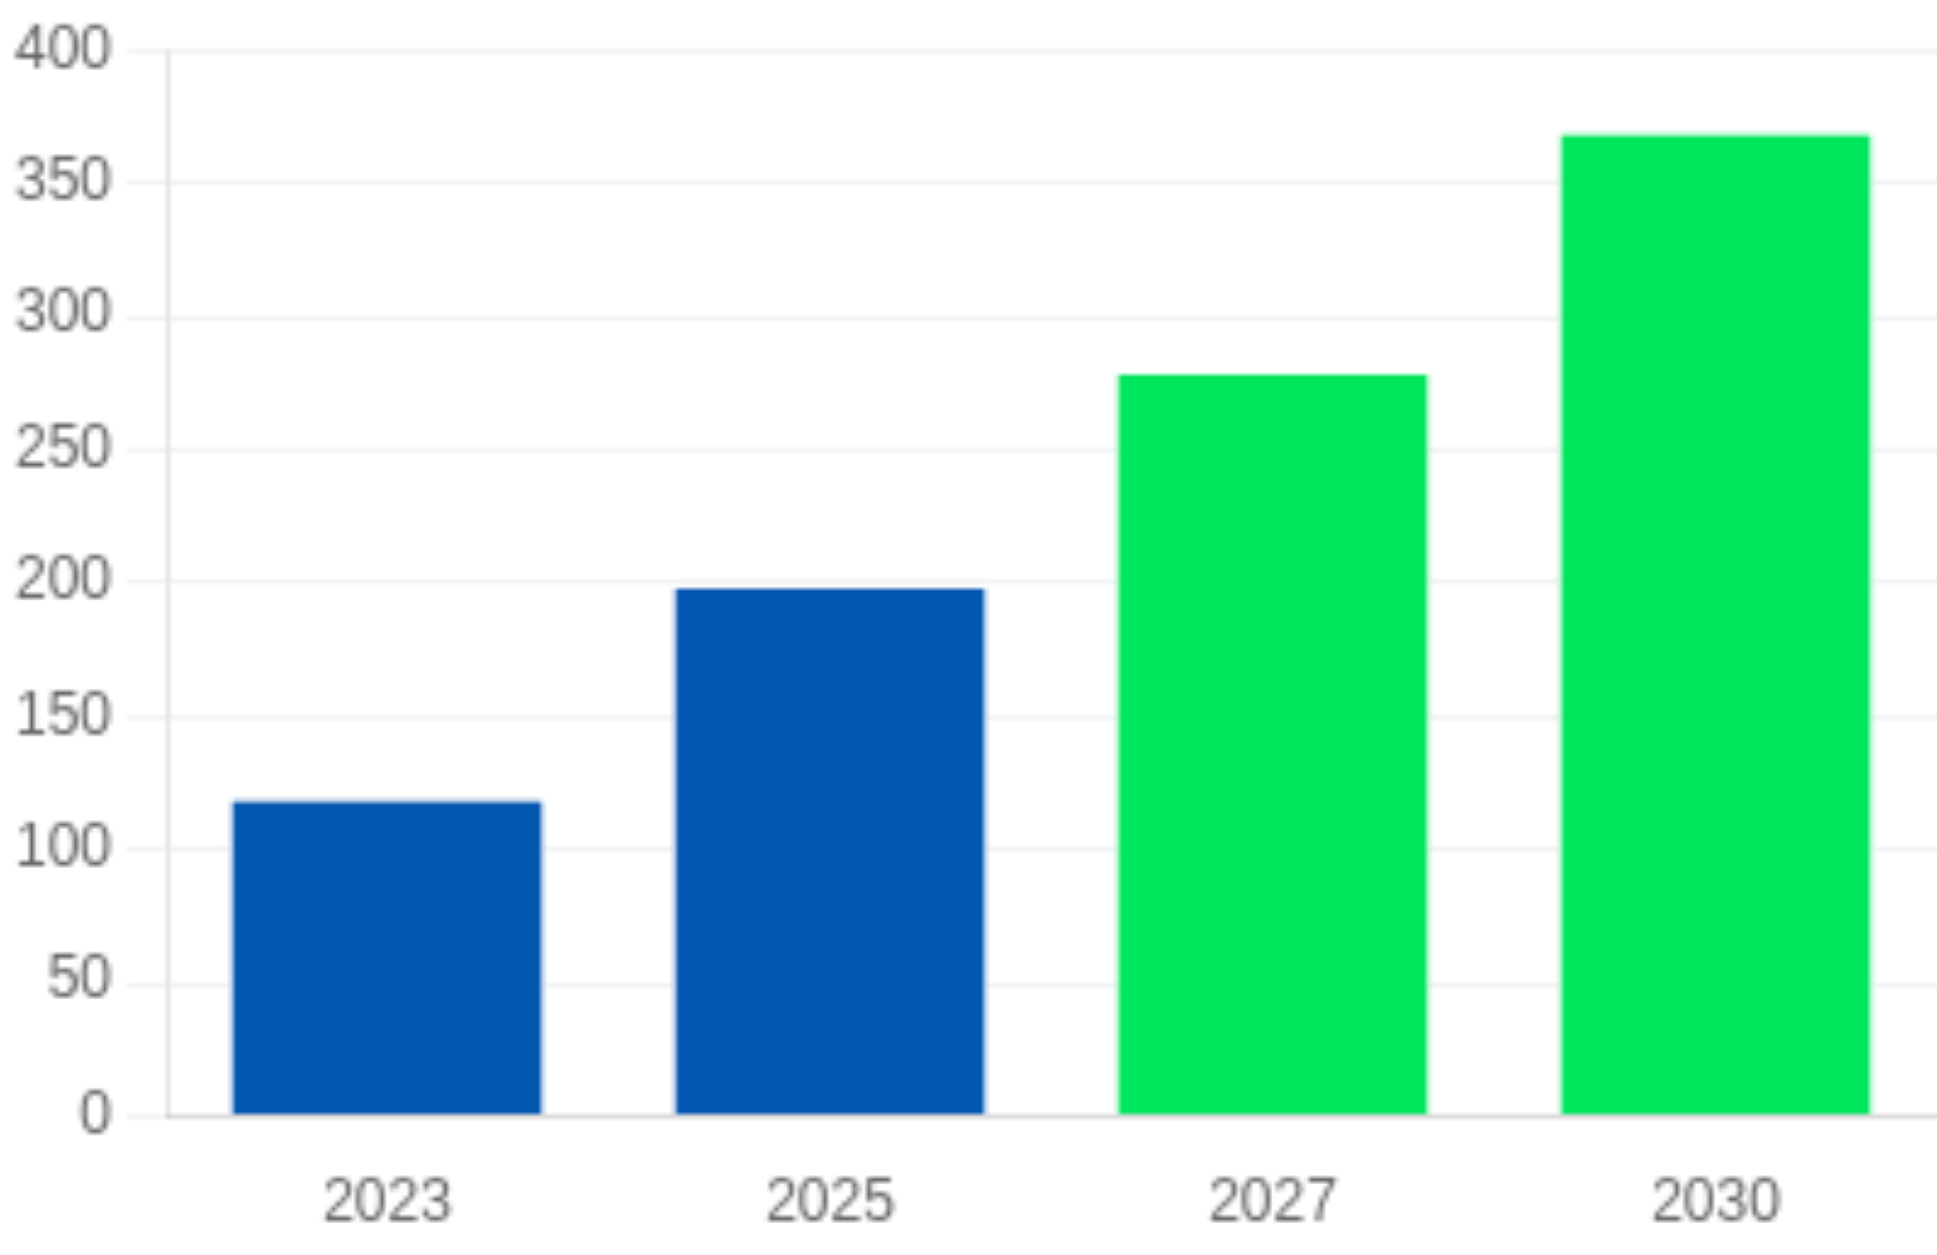
Strategic Context
Traditional Banks Under Pressure
Revenue-cost squeeze, risk of commoditization; becoming non-competitive vs fintechs and digital challengers
Banking Industry Profit Potential from AI
Fintech Surge
India's FinTech market booming (projected USD 150B by 2025), digital-savvy consumers expect personalized experiences like Amazon/Netflix
GenAI Opportunity
AI-driven services represent massive prospect: $370+ billion in new annual profit pools for retail banks by 2030 (BCG)

Slide 3
Customer Journey Map
As-Is Journey
To-Be Journey
Manual Money Management
AI-Powered Financial Wellness
Customers manually check balances, juggle bill payments, receive static alerts
Salary Received → instant savings plan
Delayed Decision Support
Real-Time Financial Insights
Key financial moments arrive without timely guidance, leading to frustration
Unusual Spending → alert & budget tip
Missed Opportunities
Lack of personalized insights results in suboptimal financial decisions
Proactive Financial Assistance
Upcoming Bill → automated reminder
Generic Notifications
Goal-Oriented Recommendations
One-size-fits-all alerts that don't account for individual circumstances
Planning Vacation → tailored savings

Slide 4
Product Architecture
Data Sources (Consent-Based)
Enterprise Data Platform (CDP / Lakehouse)
Analytics & AI Intelligence
Event & Decision Engine
Experience & Integration
Business Outcomes
Real-time business actions
Where business users consume insights
Customers
Core Banking Systems
ML & Analytics
Salary → savings nudge
Financial clarity
Account Aggregator
Bronze – Raw Data
Spend classification
Bill due → reminder
Mobile Banking App
Goal planning
Anomaly detection
GenAI Chatbot
Credit Bureau
Transaction feeds
Unusual spend → alert
APIs for CRM / RM
Reduced anxiety
User Inputs
AA ingestion
Goal feasibility
Affordability models
Kafka / Event streaming
Secure APIs • Microservices
Bank
Secure • Consent-driven • Regulated
Logs & events
GenAI Orchestration
Higher engagement
Silver – Cleaned & Enriched
Financial summaries
Cross-sell opportunities
Spend categorization
Personalized nudges
Lower cost-to-serve
Merchant normalization
Recommendations
Risk & Compliance
Customer 360 view
Context memory
Explainable decisions
Gold – AI-Ready Features
LLMs • LangChain-style orchestration
Audit readiness
Monthly spend summaries
Regulatory confidence
Cash-flow patterns
•
Goal readiness indicators
Governance, Security & Compliance
Risk metrics
RBI AA consent
DPDP compliance
Explainable AI
Human-in-the-loop
RBI FREE-AI
Implemented by Hoonartek

Slide 5
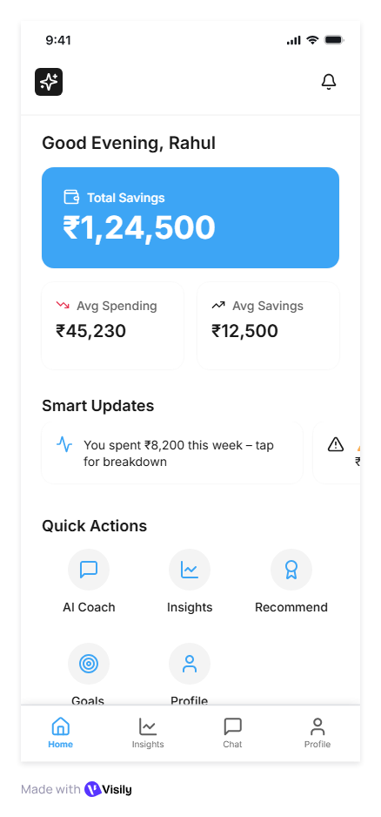
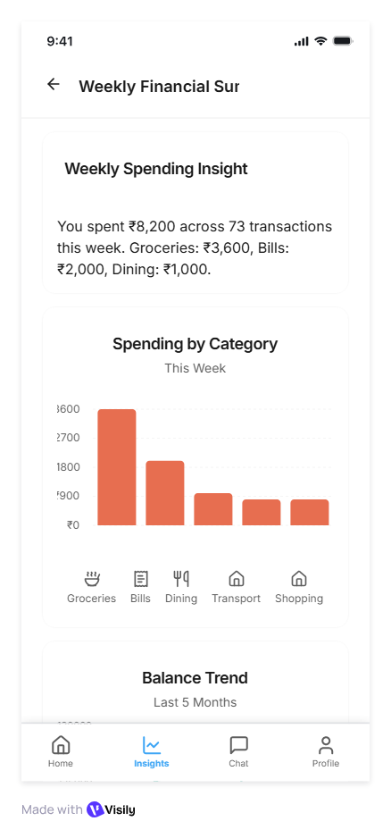
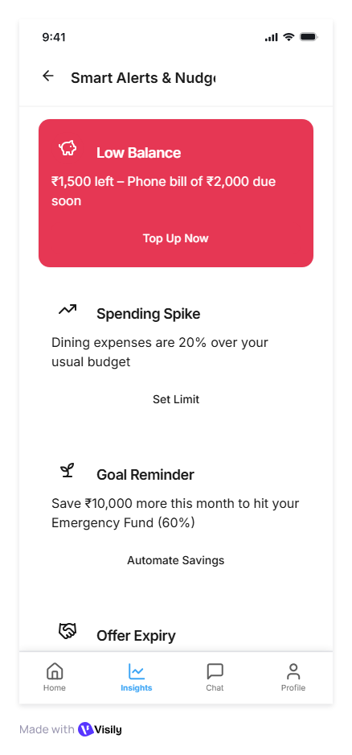
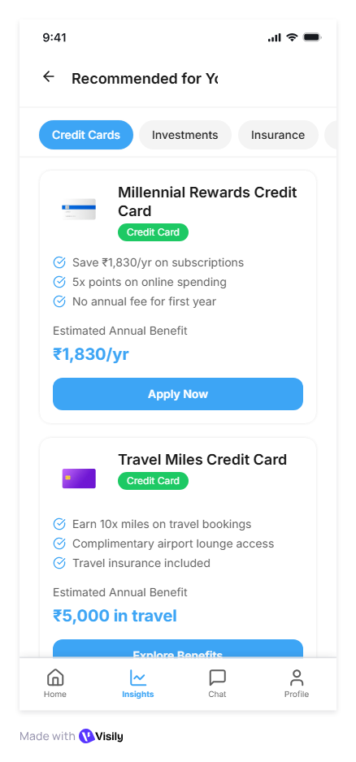
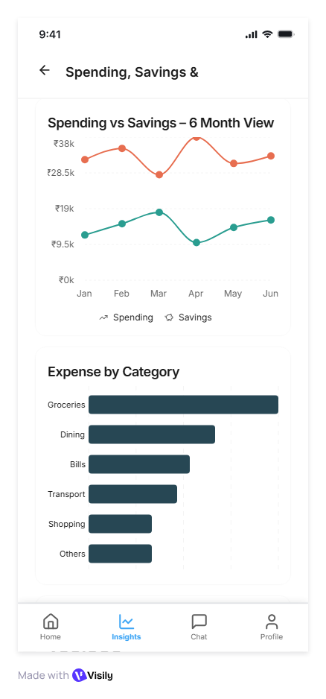
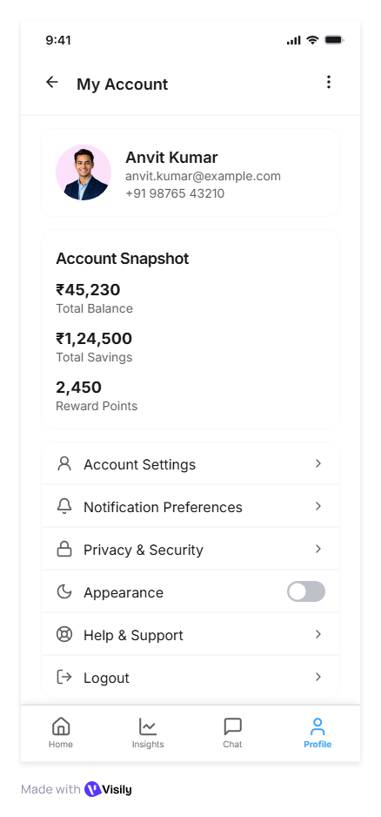
Prototype Screens: Complete App Flow
Home Dashboard
Weekly Spending Summary
Smart Alerts
Product Recommendations
Spending, Savings & Goals
My Account

Slide 6
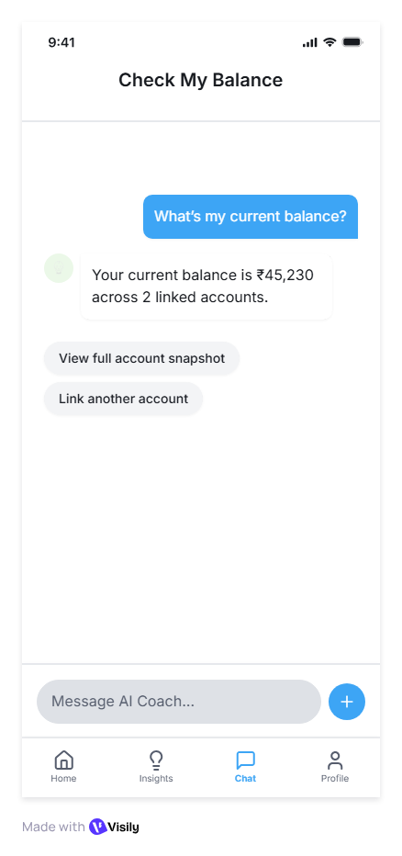
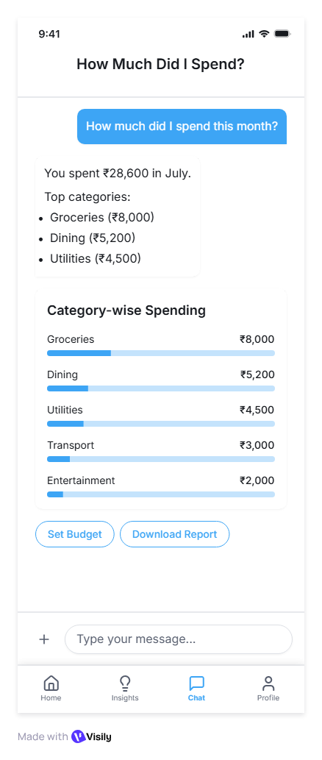
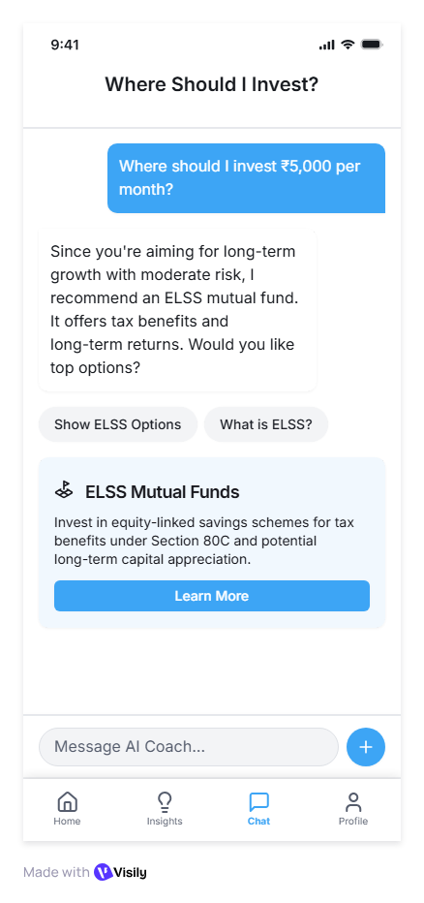
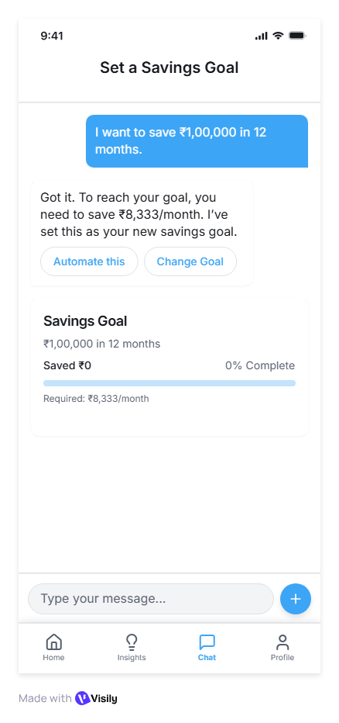
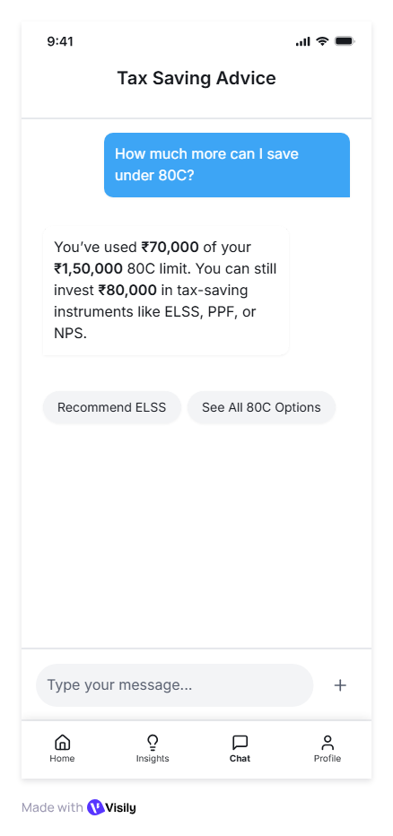
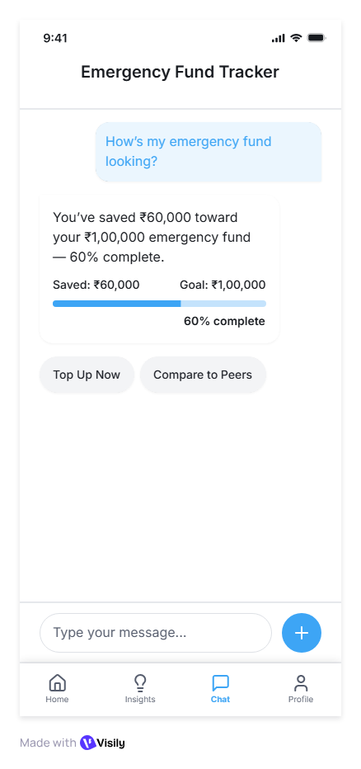
Prototype Screens: AI Coach Assistant Flow
Check Balance
Monthly Spending Summary
Investment Suggestions
Set Savings Goal
Tax Saving Advice
Emergency Fund Tracker

Slide 7
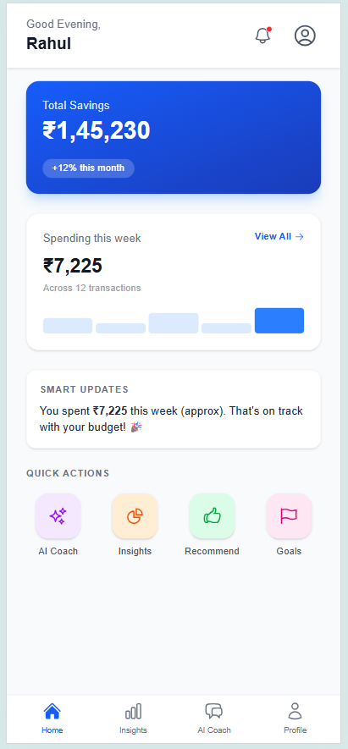
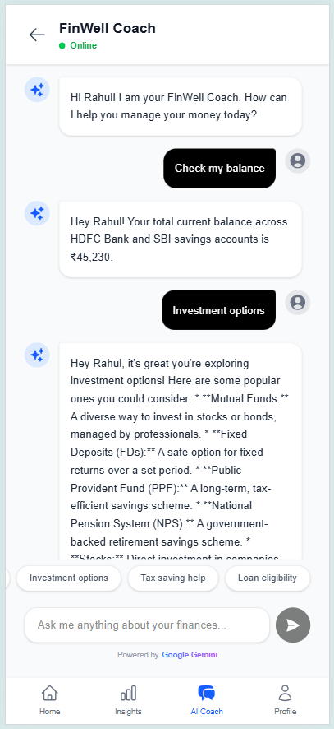
AI Coach – Live Prototype
Experience Validation
Illustrative User Journey
Live Prototype
Business Value for the Bank
1
Customer logs into mobile banking app
Higher customer engagement through proactive insights
2
AI Coach summarizes monthly income, spend, and cash flow
Contextual cross-sell of loans, investments, and savings
3
Detects unusual spend or upcoming obligations
Reduced dependency on branches and relationship managers
4
Provides personalized nudges and insights
Improved personalization at scale
Lower cost-to-serve through digital nudges
5
Suggests relevant financial action or product
Stronger trust via transparent, explainable recommendations
6
Tracks goals and improves financial discipline
FinWell
Conceptual demo for experience validation
Prototype represents an indicative workflow. Production deployment requires bank systems integration, regulatory approvals, and enterprise-grade controls.

Slide 8
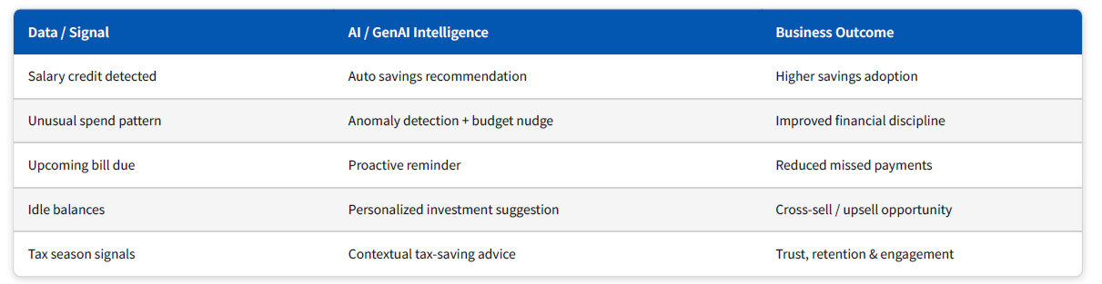
Architecture → Business Value → Hoonartek Role
How the GenAI Architecture Creates Measurable Business Impact
From Data Signals to Business Outcomes
AI converts raw banking data into proactive, personalized financial guidance
Where Hoonartek Enables Value
DATA FOUNDATION
AI & GENAI ENABLEMENT
GOVERNANCE & SCALE
Data ingestion from CBS & AA
ML models (spend, risk, goals)
Security & DPDP compliance
CDP / Lakehouse (Bronze–Silver–Gold)
GenAI orchestration (summaries, nudges)
Explainable AI & audit trails
Customer 360 & feature engineering
Hybrid rule + AI decisioning
Enterprise rollout & monitoring
AI-ready, governed data
Explainable, compliant intelligence
Trusted, scalable deployment
Hoonartek enables banks to move from transaction processing to trusted, AI-powered financial coaching

Slide 9
Roadmap & Recommendations
Implementation Roadmap
Key Takeaways & Strategic Recommendations
Phase 1: Pilot
Phase 2: Scale
Phase 3: Optimize
Q1/Q2
Q3/Q4
GenAI Advisor as strategic differentiator — drives engagement, loyalty, efficiency
Year 2
Core MVP development
Full feature deployment
Cross-functional alignment required — IT/Cloud, Data Science, Compliance, UX
Advanced AI features
Bank-wide integration
Partner alignment — regulatory bodies, fintech/API providers, AI-tech vendors
Internal testing & validation
Cross-product integration
Performance optimization
Limited user beta program
Market expansion
Invest in talent — data scientists, UX designers, robust monitoring & governance
User feedback iteration
Continuous improvement
Regulatory compliance setup
Early compliance readiness, agile cycles, continuous user feedback & iteration

Slide 10
Risk & Compliance
Trust (Transparency)
People First & Fairness
Accountability & Explainability
Clear communication of AI capabilities and limitations
Ensuring AI systems treat all customers equitably
Clear responsibility for AI decisions and reasoning
Transparent AI advice with explainability
Bias detection and mitigation protocols
Human oversight & escalation paths
Clear disclosure of AI involvement
Inclusive design for diverse user needs
Comprehensive audit trails
Resilience & Safety
Data Privacy & DPDP
Regulatory Alignment
Robust systems that maintain performance under stress
Protecting customer data and complying with privacy laws
Ensuring compliance with financial regulations
Regular security testing & updates
Consent flow via Account Aggregator
RBI's FREE-AI principles compliance
Fail-safe mechanisms for critical functions
Encryption & data deletion policy
Regular regulatory reviews & updates

Slide 11
Thank You

